Slide 1

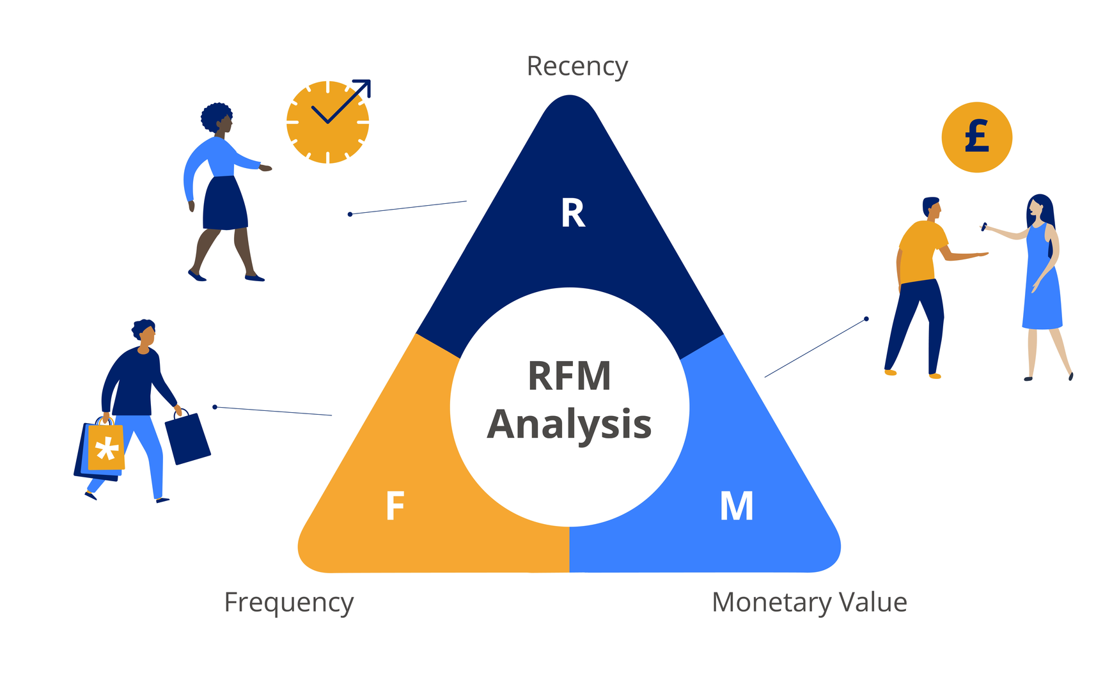
RFM ANALYSIS
GROUP 15
LHP: DHHTTT17 - 420301417701
GVHD: ThS. Huỳnh Nam

Slide 2
ORDINAL NUMBER | FIRST AND LAST NAME | STUDENT CODE
1 | Huỳnh Thị Thùy Linh | 20002435
2 | Nguyễn Thị Mỹ Liên | 20002325
3 | Phạm Duy Vũ | 20000445
4 | Nguyễn Bá Điền
MEMBERS OF THE GROUP

Slide 3

GENERALITY
PART 1: RFM ANALYSIS
I. Learn about customer segments
II. RFM analysis
III. Analyze RFM for effective customer segmentation
PART 2: DEMO

Slide 4
PART 1: RFM ANALYSIS

Slide 5

I. LEARN ABOUT CUSTOMER SEGMENTS
WHAT IS CUSTOMER SEGMENTATION?
POPULAR CUSTOMER SEGMENTS

Slide 6

1.WHAT IS CUSTOMER SEGMENTATION
Customer segmentation is a group of customers divided according to specific characteristics. Each different customer segment will have different characteristics and purchasing behaviors, affecting the business strategy of the enterprise.

Slide 7
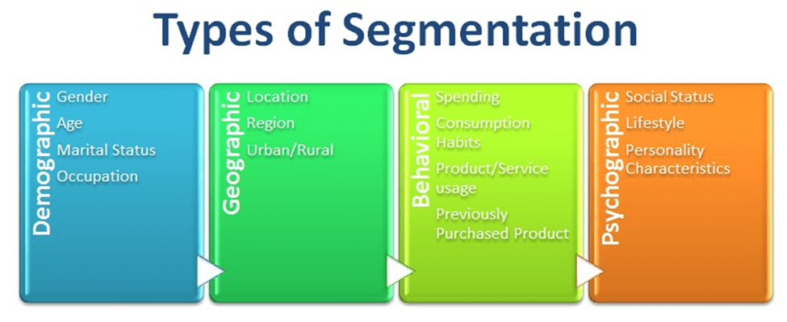
2.POPULAR CUSTOMER SEGMENTS
Segment customers by demographics
Segment customers by purchasing behavior
Segment customers according to purchase journey
Segment customers by device used

Slide 8
II. RFM ANALYSIS
What is RMF?
Benefits of RFM
Advantages and Disadvantages of RFM
The benefits of RFM bring many to businesses.
Relationship between customer segmentation and RFM
RFM application

Slide 9
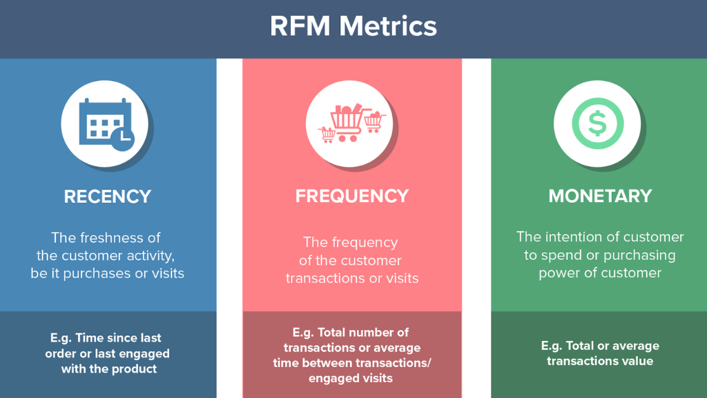
1.WHAT IS RMF?
Recency
The most recent level of the transaction
Frequency
Frequency of making transactions
Monetary
Valuable transaction

Slide 10
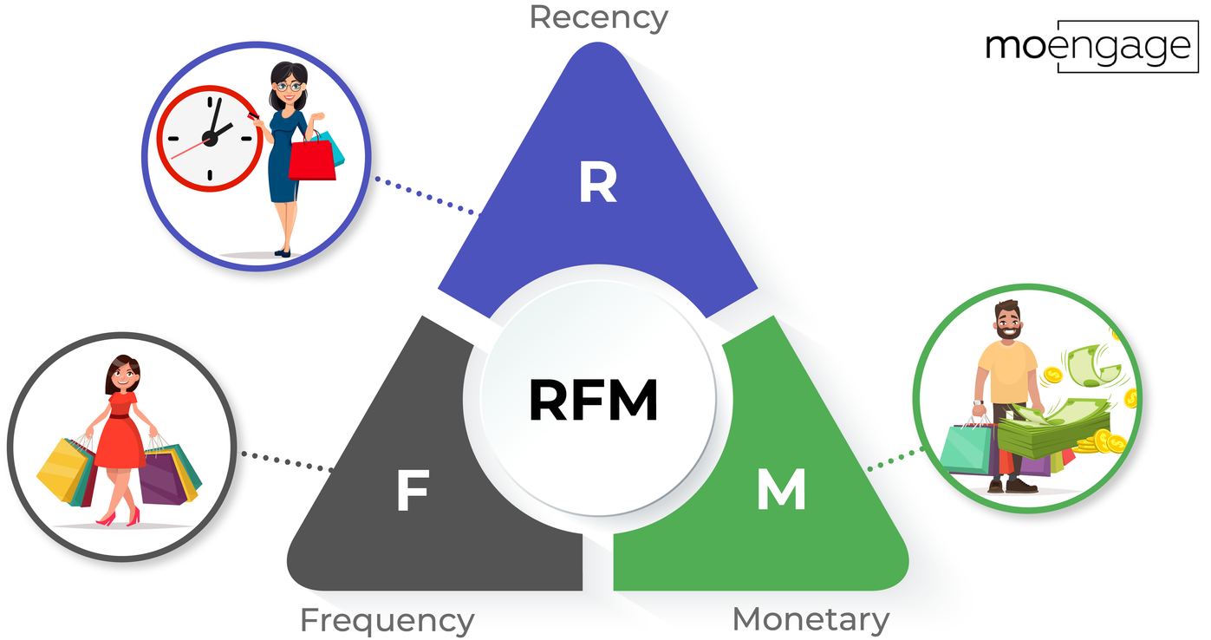
2. BENEFITS OF RFM
Increase customer retention rate.
Increase response speed from customers.
Increase revenue rate from customers.
Increase email marketing effectiveness
·Improve customer lifetime value
Increase loyalty and increase customer interaction
Reduce the rate of customers leaving the business

Slide 11

3. ADVANTAGES AND DISADVANTAGES OF RFM
Advantage
RFM can be applied to different types of businesses
It can lead to reduced marketing costs by helping you target the right customers
Data can be a good source for customer loyalty programs
It can be combined with other analytical tools for better understanding
It can help you identify your best customers
Defect
Calculating RFM scores can be difficult
RFM analysis depends on historical data and not future prospects
This analysis may not be appropriate if you only sell one product

Slide 12
4.The benefits of RFM bring many to businesses
Identify the potential of customer groups
Design marketing strategies suitable for each customer group
Optimize business performance

Slide 13
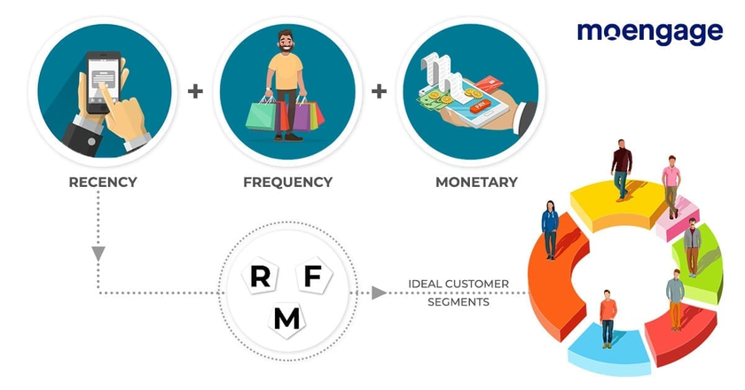
5. RELATIONSHIP BETWEEN CUSTOMER SEGMENTATION AND RFM
For example, a business that sells clothing might segment customers based on RFM as follows:
Potential customers: Customers with high RFM, i.e. customers who transact recently, frequently and spend a lot. Businesses can focus resources to care for and develop this group of customers.
Current customers: Customers with low RFM, that is, customers who have been trading for a long time, shop less and spend less. Businesses can develop promotional programs to stimulate this group of customers to shop more.
Returning customers: Customers who once shopped at the business but are no longer shopping. Businesses can develop gratitude programs to attract this group of customers to return to shopping.
=> Customer segmentation and RFM are two important tools that help businesses understand their customers better. Combining the use of these two tools will help businesses design marketing strategies

Slide 14
6. RFM APPLICATION
Marketing: Businesses use RFM to identify and target higher-potential customers to create more effective marketing campaigns. RFM helps divide customers into groups such as "loyal customers" or "prospective customers."
Customer management: RFM helps businesses track and manage relationships with customers in the best way. It helps focus resources on maintaining and developing important relationships.
Retail and e-commerce: RFM can help businesses identify customers who are likely to shop more and create promotions based on customer demographics.
Banking and finance: Financial institutions can use RFM to assess the risk and value of customer accounts

Slide 15
II. RFM ANALYSIS FOR EFFECTIVE CUSTOMER SEGMENTATION
Customer segmentation according to the RFM model is a powerful technique that helps businesses group customers based on their behavior and transaction history.
By analyzing three main indicators: Recency - Frequency - Monetary Value, businesses can identify groups of customers who buy frequently, spend a lot or groups of customers who are likely to return and remarket to those customers. Personalized messages, bringing better results.

Slide 16

PART 2: DEMO

Slide 17
STT | Tên | Mô tả
01 | InvoiceNo | Hóa đơn không có
02 | StockCode | Mã
03 | Description | Miêu tả
04 | Quantity | Số lượng
05 | InvoiceDate | Ngày hóa đơn
06 | UnitPrice | Đơn vị giá
07 | CustomerID | ID khách hàng
08 | Country | Quốc gia

Slide 18
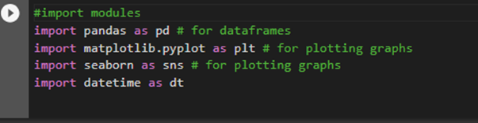
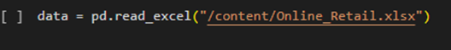
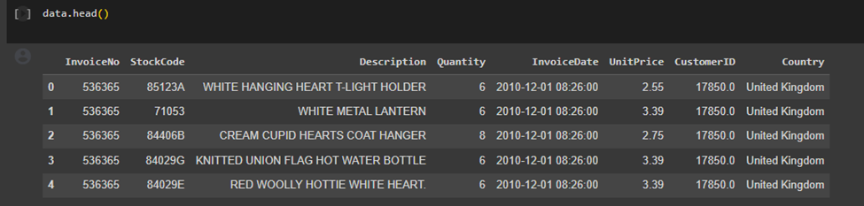
- IMPORT AND IMPORT REQUIRED DATA
- Data processing
-DISPLAYS THE COLUMN'S NAME DATAFRAME

Slide 19
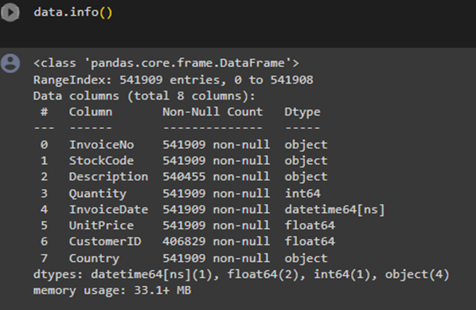
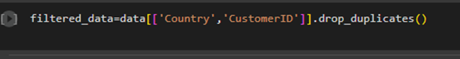
-Display data objects
-REMOVE DUPLICATES

Slide 20
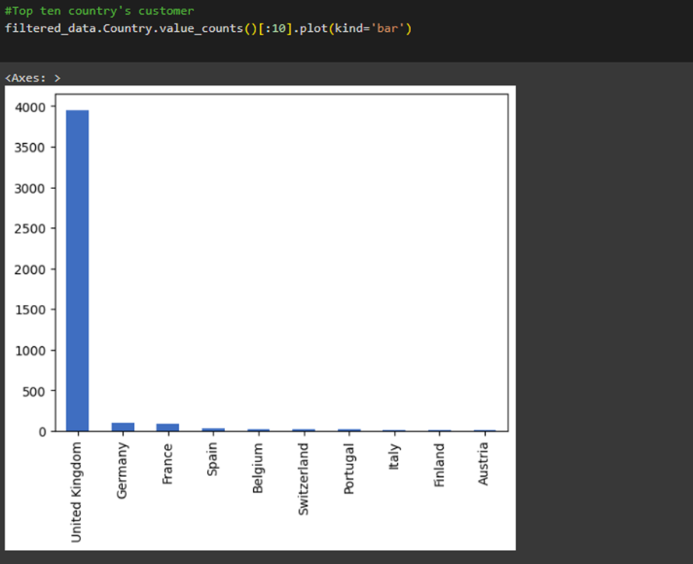
- DETAILED INFORMATION ABOUT DATA
This code is drawing a bar chart of the 10 countries with the most customers.
Filtered_data.Country.value_counts() returns a Pandas String object containing the total number of unique values ​​in the 'Country' column of the 'filtered_data' DataFrame.
[:10] is used to trim the first 10 values ​​of the Series object.
.plot(kind='bar') is used to plot a sliced ​​Series object as a bar chart.
The type parameter is set to 'bar' to determine the chart type.

Slide 21
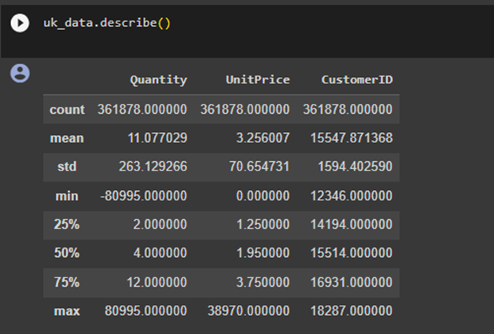
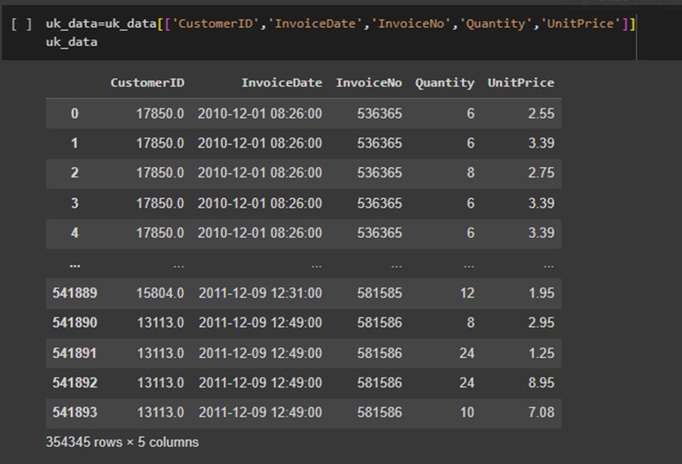
- Describes data in DataFrame
- Filter necessary columns

Slide 22
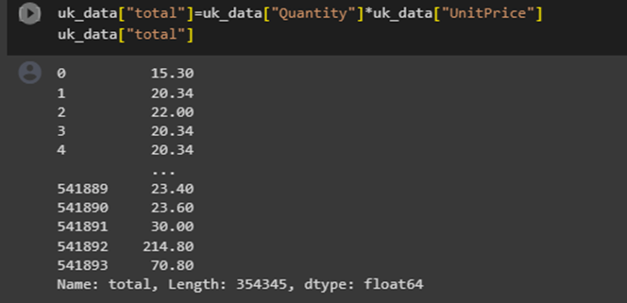
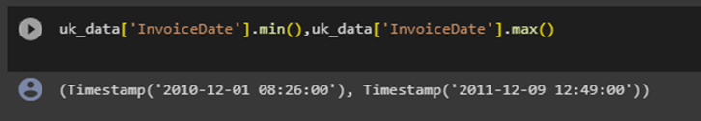
-CREATE TOTAL COLUMN
FIND MIN, MAX IN INVOICEDATE

Slide 23
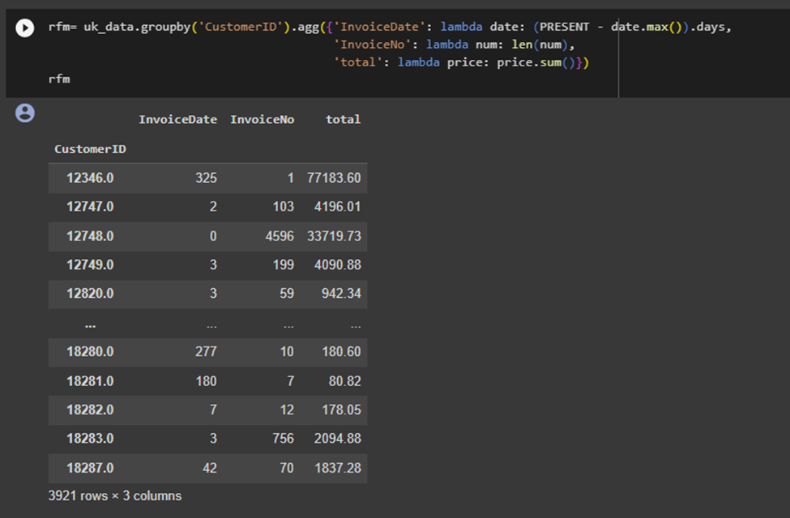
- RFM

Slide 24
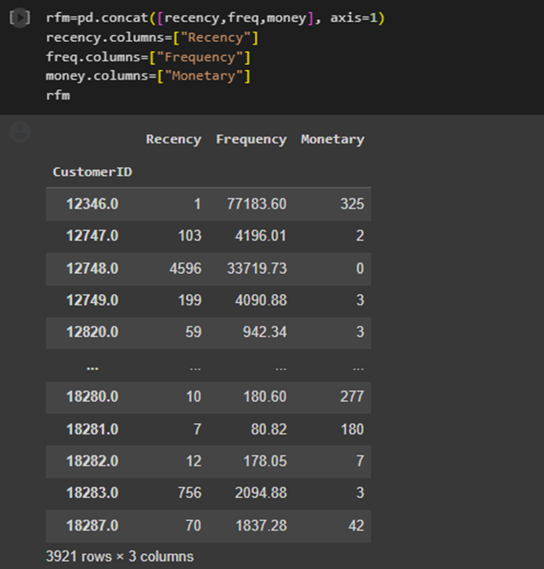
ID: customer identification information
Monetary: the total amount a customer has paid to a company over the life of their purchase calculated by adding up the values ​​of all the amounts the customer has paid to the company
Frequency: transaction frequency is calculated by dividing the total number of purchases by the time between the first and last purchases
Recency: the time period from the last transaction minus the date the customer actually made the first transaction

Slide 25
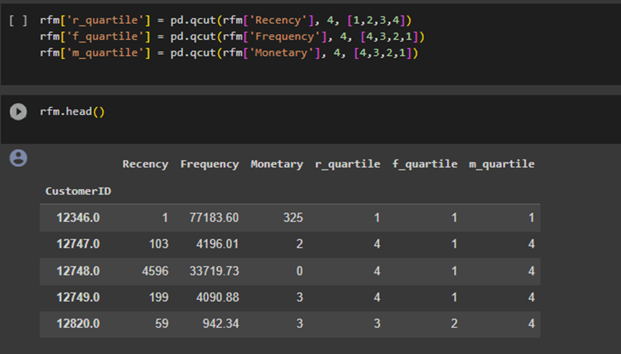
- QUANTUM CALCULATION OF RFM VALUES

Slide 26
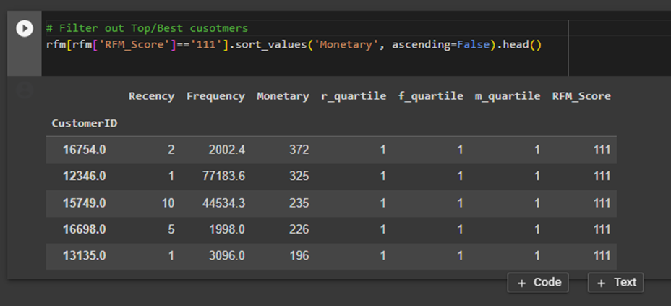
- Filter top/best customers of the data set

Slide 27
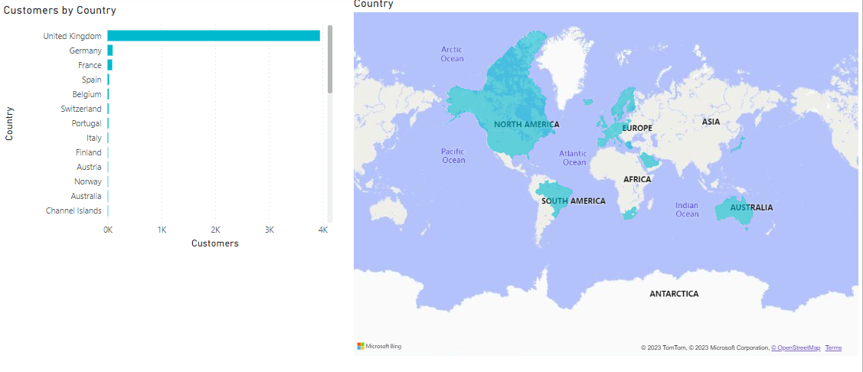

Slide 28
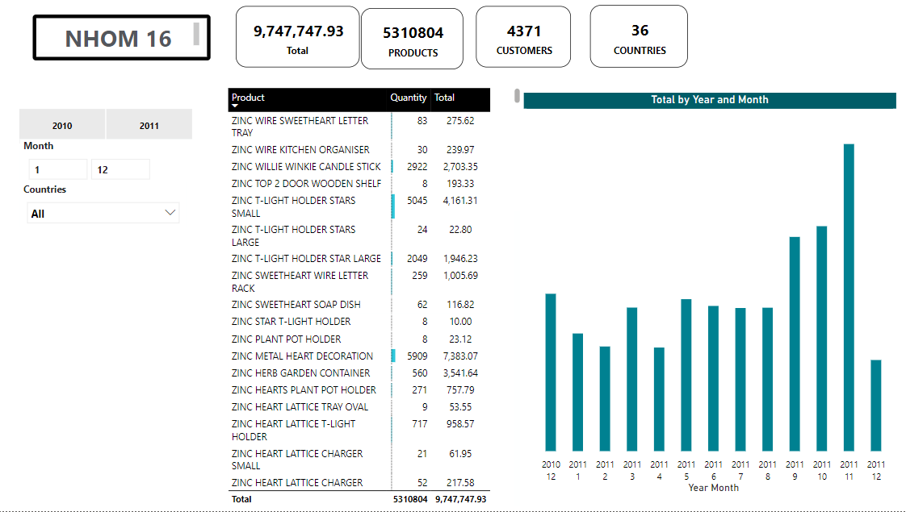

Slide 29
THANK YOU

